Slide 1
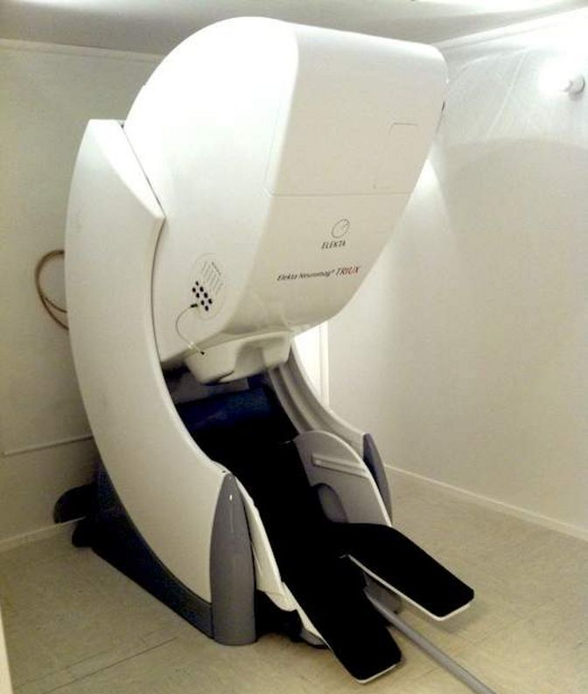
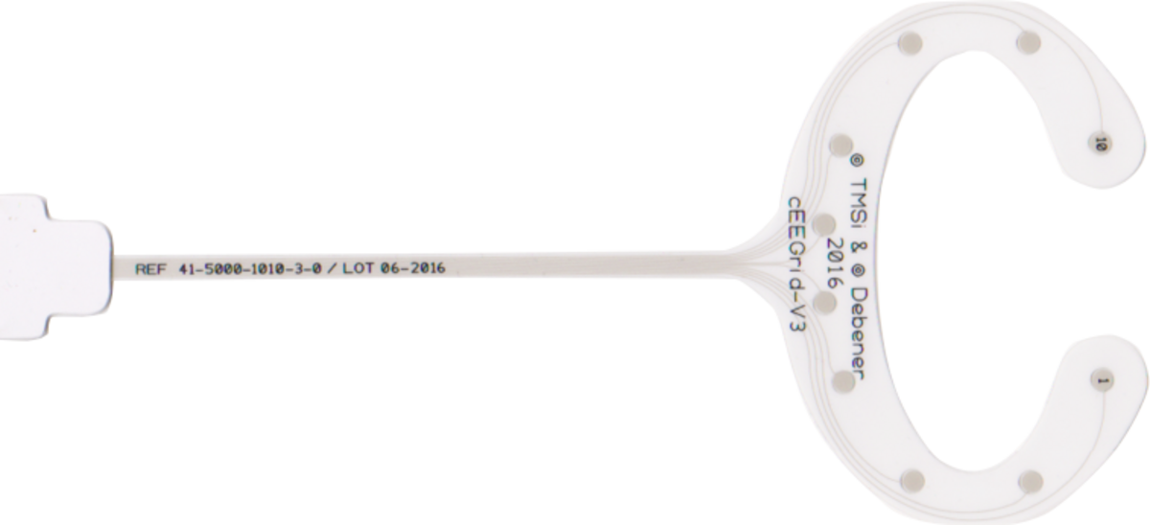
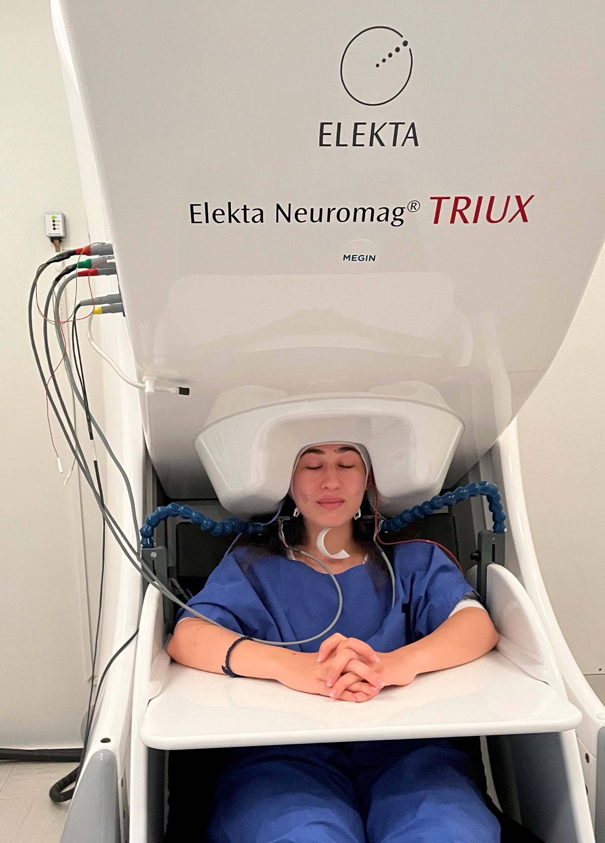
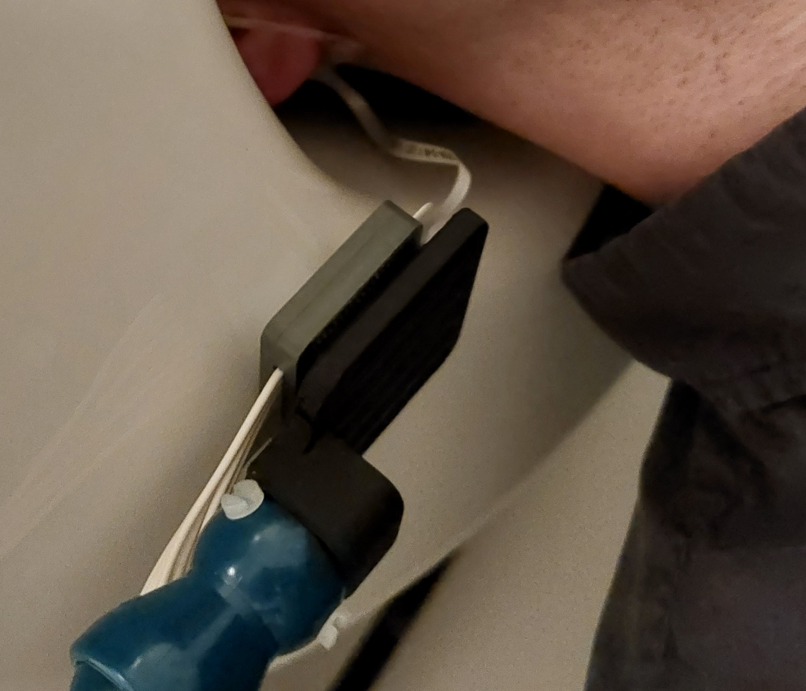
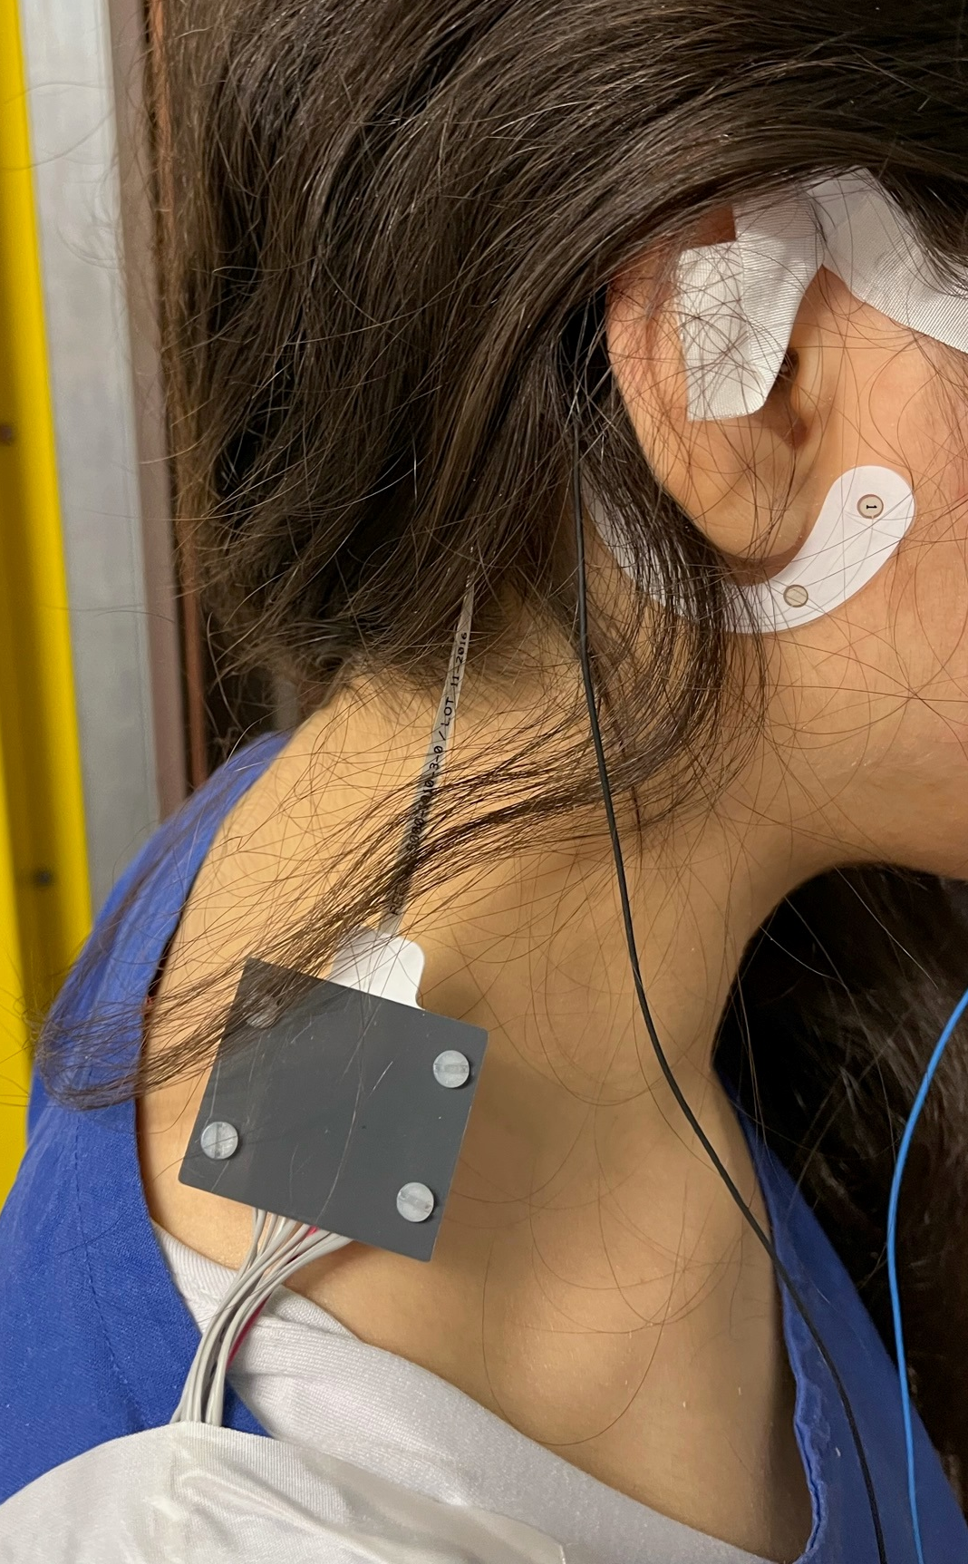
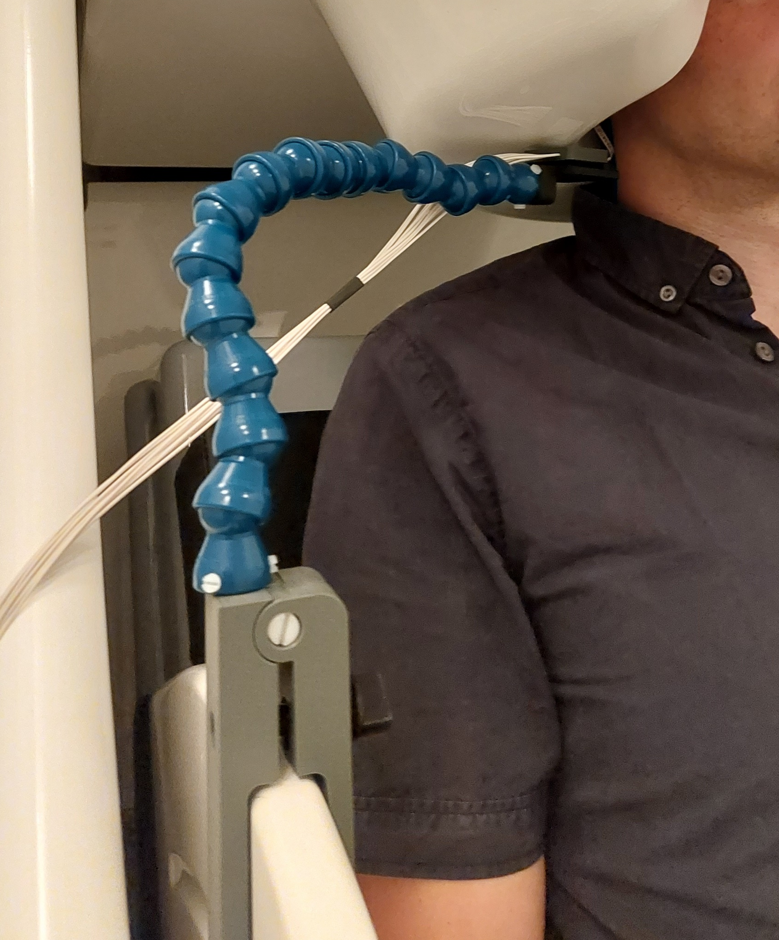
Ear-EEG compares well to MEG in recording auditory ERPs?
Till Habersetzer, Martin Bleichner, Andreas Spiegler

Slide 2
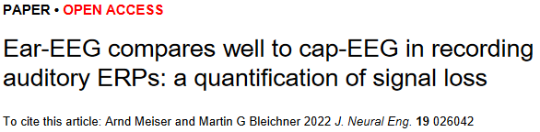
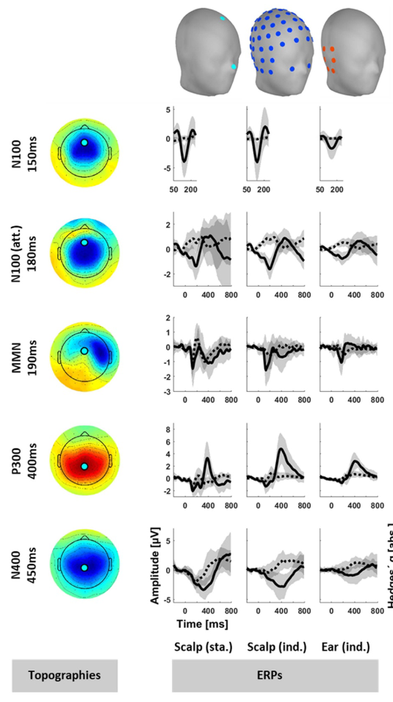
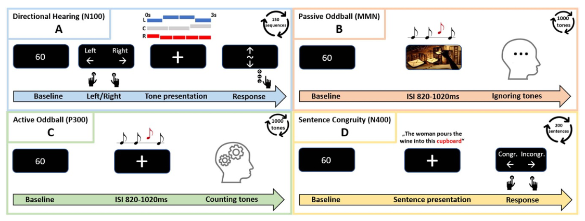
Ear-EEG compares well to MEG in recording auditory ERPs?

Slide 3
Ear-EEG compares well to MEG in recording auditory ERPs?
Contraindications - Who can not participate?
To avoid magnetic interactions – especially with metals – because they reduce the measurement accuracy, no metals should be worn on your body during the measurements.
No pacemakers, neuro-stimulators, insulin pumps or hearing devices.
No metallic implants, they also have the possibility to be ferro magnetic (Retainer!!)
Tattoos (also permanent make-up) can contain color particles with metallic parts in it.
Also cosmetics such as mascaras, rouge or even styling gel can contain metal. Please avoid using those on the day of measurement.
…
We are planning to include an anatomical MRI of your brain in this project

